Slide 1
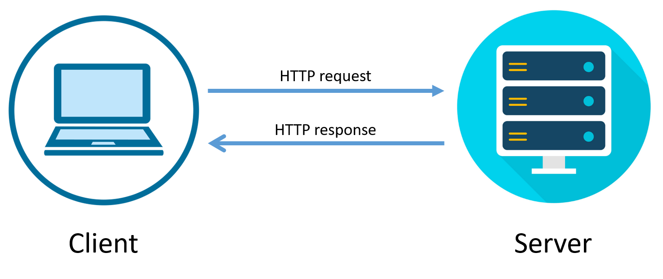

TEAM AURORA
“None of us is as smart as all of us”
Webpage Request Life Cycle
Done By
Mani Maran V

Slide 2
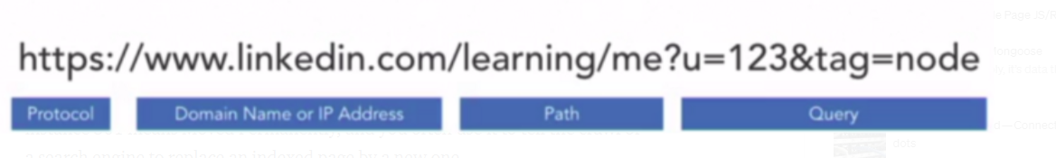
WebPage Request Life Cycle
A web server reads and interprets URLs and HTTP requests so that it can, in turn, serve up static files to the client in response (HTML, CSS, JavaScript, and image files).
URL:
URL - Uniform Resource Locator, consists of the following: protocol, domain, port, path, and a query string.

Slide 3
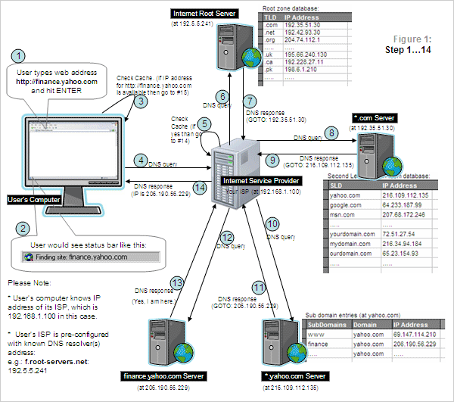
WebPage Request Life Cycle

Slide 4
WebPage Request Life Cycle
User type web address http://finance.yahoo.com and hit Enter from User’s Computer
User would see status bar like this: “finding site: finance.yahoo.com”
Check Cache(if IP address for http://finance.yahoo.com is available then go to #15.
DNS Query from User’s Computer to Internet Service Provider (at 192.168.1.100)
Check Cache(if yes then go to #14.)
DNS Query from Internet Service Provider to Internet Root Server (at 192.5.5.241)
DNS Response from Internet Root Server to Internet Service Provider (GO TO 192.35.51.30)
DNS Query from Internet Service Provider to *.com Server(at 192.35.51.30)
DNS Response from *.com Server to Internet Service Provider (GO TO 216.109.112.135)
DNS Query from Internet Service Provider to *.yahoo.com server (at 216.109.112.135)
DNS Response from *.yahoo.com server to Internet Service Provider(GO TO 206.190.56.229)
DNS Query from Internet Service Provider to finance.yahoo.com server (at 206.190.56.229)
DNS Response from finance.yahoo.com server to Internet Service Provider at 192.168.1.100 (Yes, I am here)
DNS Response from Internet Service Provider to User’s Computer (IP is 206.190.56.229)

Slide 5
WebPage Request Life Cycle
Web Browser submits the request to the server after creating a socket in local progress.
The http server waits for the request to come on socket i.e. port-80.
The web browser translates the yahoo.com to an IP address if it does not knows it.
If the web browser does not recognize the address it contacts a DNS Server to resolve the name.
The browser will open a TCP connection to the IP address of yahoo.com and send a HTTP GET request over.
The request is then submitted to DNS server where IP address is fetched based on domain name.
Now the request is submitted to Http Server as per HTTP protocol.
Http server receives the request and shifts the client to another socket.
So the socket on port-80 is released to receive request from other clients.
Web Browser & server both are connected to each other.
The server will process the request, renders the response & breaks the connection.

Slide 6


